Slide 1
Decoding the Risk Factors of Alzheimer’s Disease
Anusha Singhal, Zoe Li, Khushi Brar

Slide 2
Alzheimer’s
Progressive, irreversible brain disease
Affects memory and thinking skills
Symptoms worsen over the years
Common symptoms: memory loss, behavioral changes, functional decline
Risk factors: age, genetics, lifestyle
Notes:
Bc symptoms worsen over the years, an early diagnosis can be incrediblt helpful in managig symptions and slowing progresson
Behavioral changes: confusion, personality changes
Lifestyle: heart health, blood pressure
This can be helpful bc a clinician cant necessarily consider all these factors, but a trained classifier would be able to screen patients and identify at risk individuals at an earlier stage

Slide 3
Our Project
Classify patients with Alzheimer’s using demographic, lifestyle, and clinical variables
Identify risk factors with strong correlation
Early identification can help offset symptoms
Notes:
building a classifier to identify alzheimer’s patients
Focus on risk factor identification, so will exclude symptom variables

Slide 4
Why Should We Classify?
Slow and expensive clinical diagnosis
Non-linear interaction between clinical, lifestyle, and demographic variables
Decision tree and SVC can mimic this interaction
Allows early identification of at risk individuals and helps focus clinical screenings
Notes:
This is bc there isnt a single variable that clearly separates patients with Alzheimer’s from those without
As a result it is rarely identified early on, typically not until serious damage to the brain and neurons has been done
Since alzheimer’s likely involves non-linear identification and interaction between cognitive, lifestyle, and behavioral variables, ML classification can be used
Decision trees capture this interaction (so for example a combo of hypertension and low physical activity may indicate higher likelihood than just one alone)
SVC allows us to separate healthy patients from those with Alzheimer’s when there’s high dimensionality involved

Slide 5
Expected Results
Lifestyle factors will differentiate people more than demographics
Moderate model performance
Notes:
lifestyle factors like sleep quality will differentiate people more than demographics
Won’t get perfect results bc we’re not including symptoms, moderate model performance
Identify healthy partients better since there is an imbalance in our dataset

Slide 6
Understanding our Dataset
Alzheimer’s Disease dataset -> Globose Technology Solutions on Kaggle
Sample: 2149. Alzheimer's: 759 (35.4%), Healthy: 1390 (64.6%)
Variable | Summary
Age | 75 ± 9 years
Gender | 50% Female, 50% Male
Ethnicity | 60% Caucasian, 20% African American, 10% Asian, 10% Other
Education Level | 20.8% None, 39.7% High School, 29.6% Bachelor’s, 9.9% Higher
Notes:
where did you find the dataset? How many datapoints? What are the properties of each datapoint? It is useful to provide examples.
Descriptive stats of the properties
e.g. , for the properties you are interested in, what do the histogram distributions look like? What are the mean, SD, minimal, and maximal values? Are there outliers? If so, do you plan to remove those outliers?

Slide 7
Understanding our Dataset
Variables (32) | Demographics (categorical) (PatientID, Age, Gender, Ethnicity, EducationLevel)
 | Lifestyle Factors (BMI, Smoking, AlcoholConsumption, PhysicalActivity, DietQuality, SleepQuality)
 | Medical History (categorical) (FamilyHistoryAlzheimers, CardiovascularDisease, Diabetes, Depression, HeadInjury, Hypertension)
 | Clinical Measurements (SystolicBP, DiastolicBP, CholesterolTotal, CholesterolLDL, CholesterolHDL, CholesterolTriglycerides)
 | Cognitive and Functional Assessments (MMSE, FunctionalAssessment, MemoryComplaints BehavioralProblems, ADL)
 | Symptoms (Confusion, Disorientation, PersonalityChanges, DifficultyCompletingTasks, Forgetfulness)
Outcome | Diagnosis (binary, 0= healthy, 1 = Alzheimer’s)

Slide 8
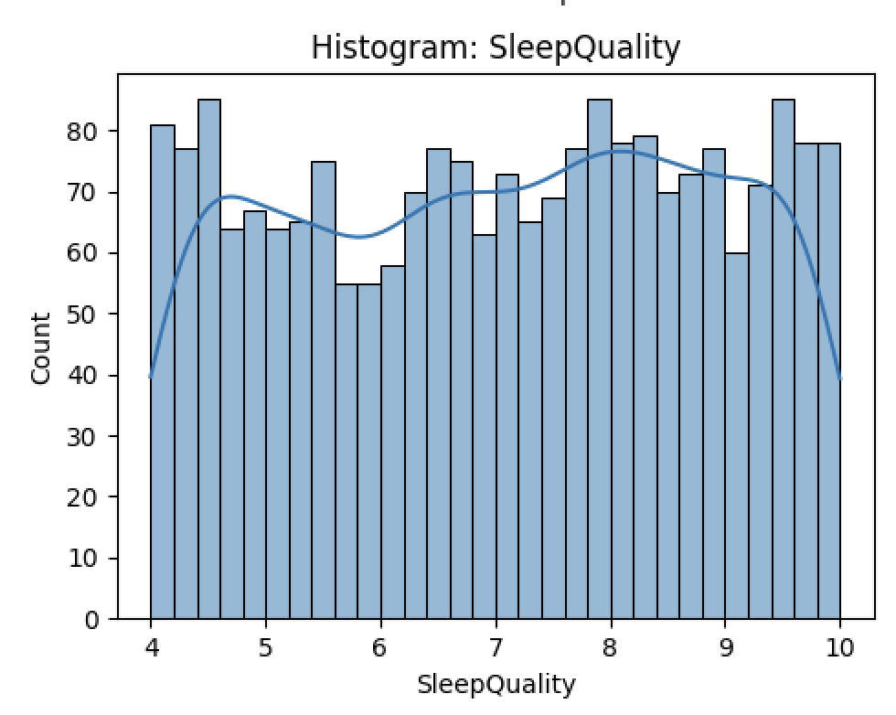
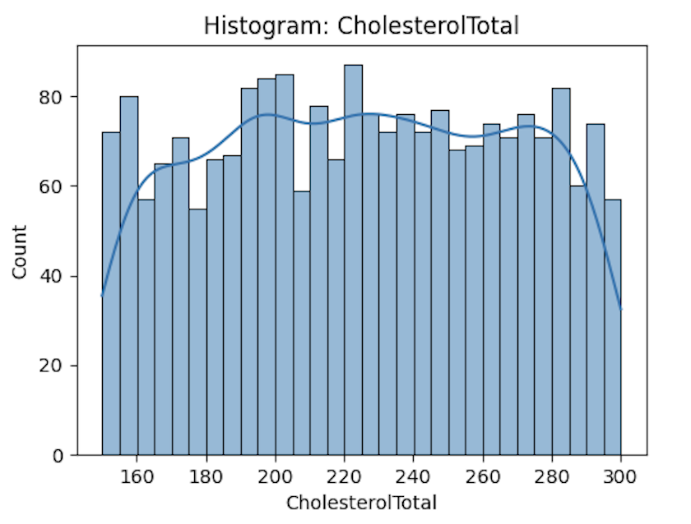
Understanding our Dataset
Outliers detection: Using the 1.5 × IQR criterion across all continuous variables, no outliers were detected in the dataset.

Slide 9
Approach
Want to classify Alzheimer’s patients from healthy individuals
Experimental Design
Decision Tree (DT) vs. Support Machine Vector (SVM)
Variables that maximally classify in DT
Kernels that perform well in SVM
Locally Linear Embedding (LLE) vs. no LLE
Notes:
A decision tree is a model that makes predictions by asking a series of yes/no questions and splitting the data step by step.
An SVM is a model that finds the best boundary that separates different groups in the data.
We chose a Decision Tree because:
Its easy to interpret: can help us see how different variables split the data and contribute to a diagnosis
shows us which features matter most, which is exactly what we’re interested in.
We also chose an SVC because:
handle complex, high-dimensional data, and we have a lot of variables
Instead of simple splits, SVC finds the best boundary to classify people
Models more complicated, non-linear patterns using kernels, which is helpful since the relationships in our data probably aren’t simple

Slide 10
Analytic Plan
Preprocess the data
Scale variables that are continuous and/or put through LLE
Remove irrelevant and symptom-focused variables
Split test (30%) and training (70%) data
Run our analyses (4 conditions)
No LLE + DT
LLE + DT
No LLE + SVM (Linear vs RBF)
LLE + SVM (Linear vs RBF)
Visualize findings + Evaluate Model Performance
Confusion Matrix, ROC AUC curve, Decision Tree
Sensitivity, specificity, accuracy, ROC AUC
Notes:
So to prepare our dataset, we scale (mean 0, sd 1) all our continuous variables, as well as variables inputted into LLE for data reduction. This is because LLE is sensitive to the scale of its inputs (like if one variable can range from 100-1000, versus another frmo 1-10, it’ll bias the model), and to make our continuous variables more interpretable. Our categorical variables are already interpretable so we left those alone.
We remove irrelevant variables (so patient id and who their doctor was), as well as variables that were symptom focused (like cognitive measures) to focus our analyses on risk-assessment.
There’s no missing values and outliers so no other processing needed.
We ran 4 conditions for our analyses, so either first reducing our dataset or not, and then doing a decision tree or support vector machine. Decision Tree is where variables are selected that maximally classify individuals on the basis of an Alzheimer’s diagnosis. There is subsequently a branching logic to continually classify individuals. For Support Vector Machines, decision boundaries are drawn in high dimensional space to attempt to classify individuals.
For all analyses, we will present a confusion matrix (so true positive and negative, as well as false positive and negative), which will inform sensitivity metrics (so how good the model is at capturing positive cases) as well as specificity metrics (so how good the model is at capturing negative cases). We will present a general accuracy measure and a more suitable ROC AUC curve metric. The ROC AUC is a measure of model accuracy that accounts for skewed datasets (so datasets that are not 50% one group and 50% another 50%, which is our case).

Slide 11
Decision Tree

Slide 12
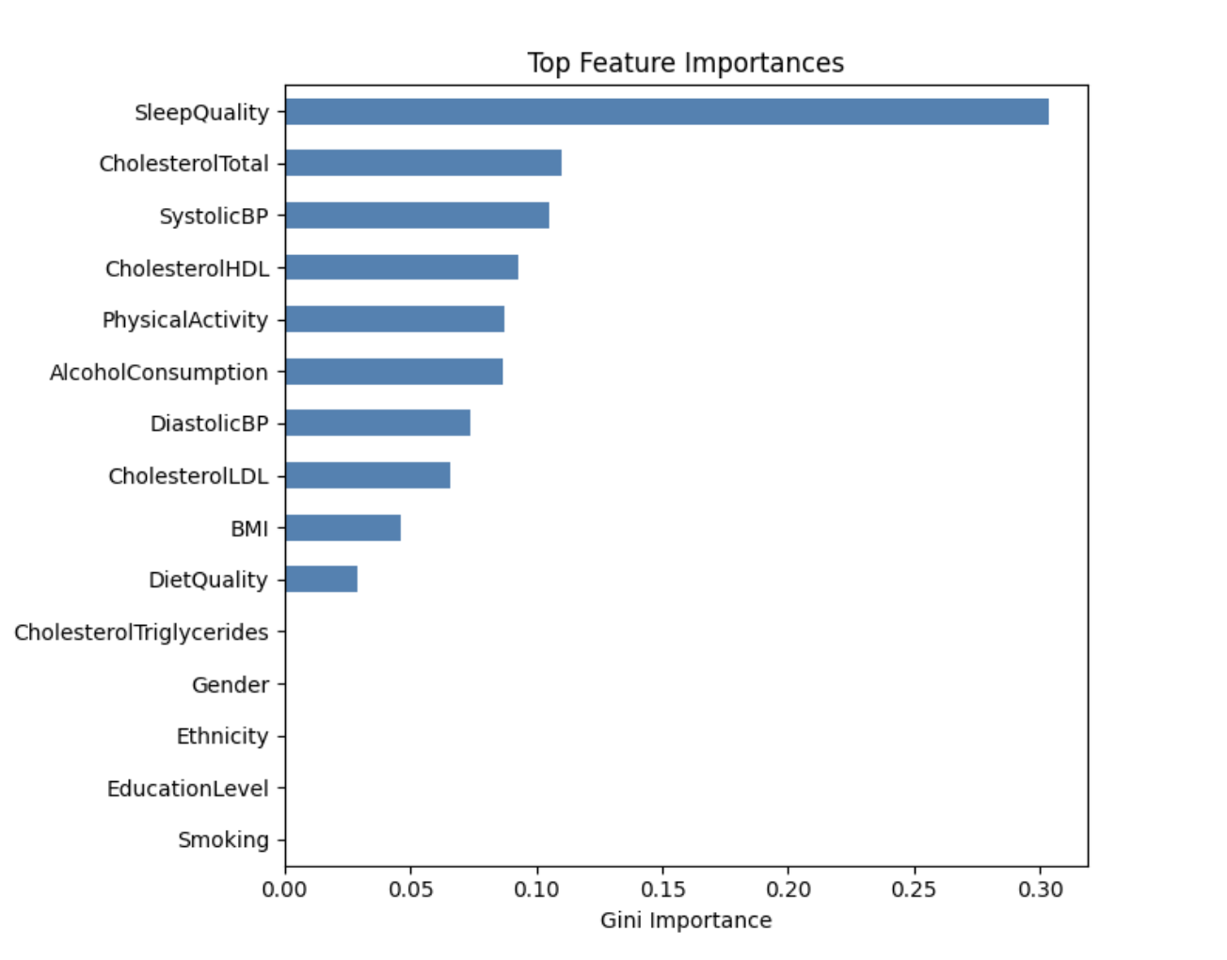
Results for the Risk-only Dataset (No LLE + DT)
Notes:
We used the ROC AUC metric to evaluate performance as well, which captures the area under the curve and tells us how good our model is at classifying our datasets in skewed datasets (meaning datasets that don’t have equal number of people with and without alzheimer’s).

Slide 13
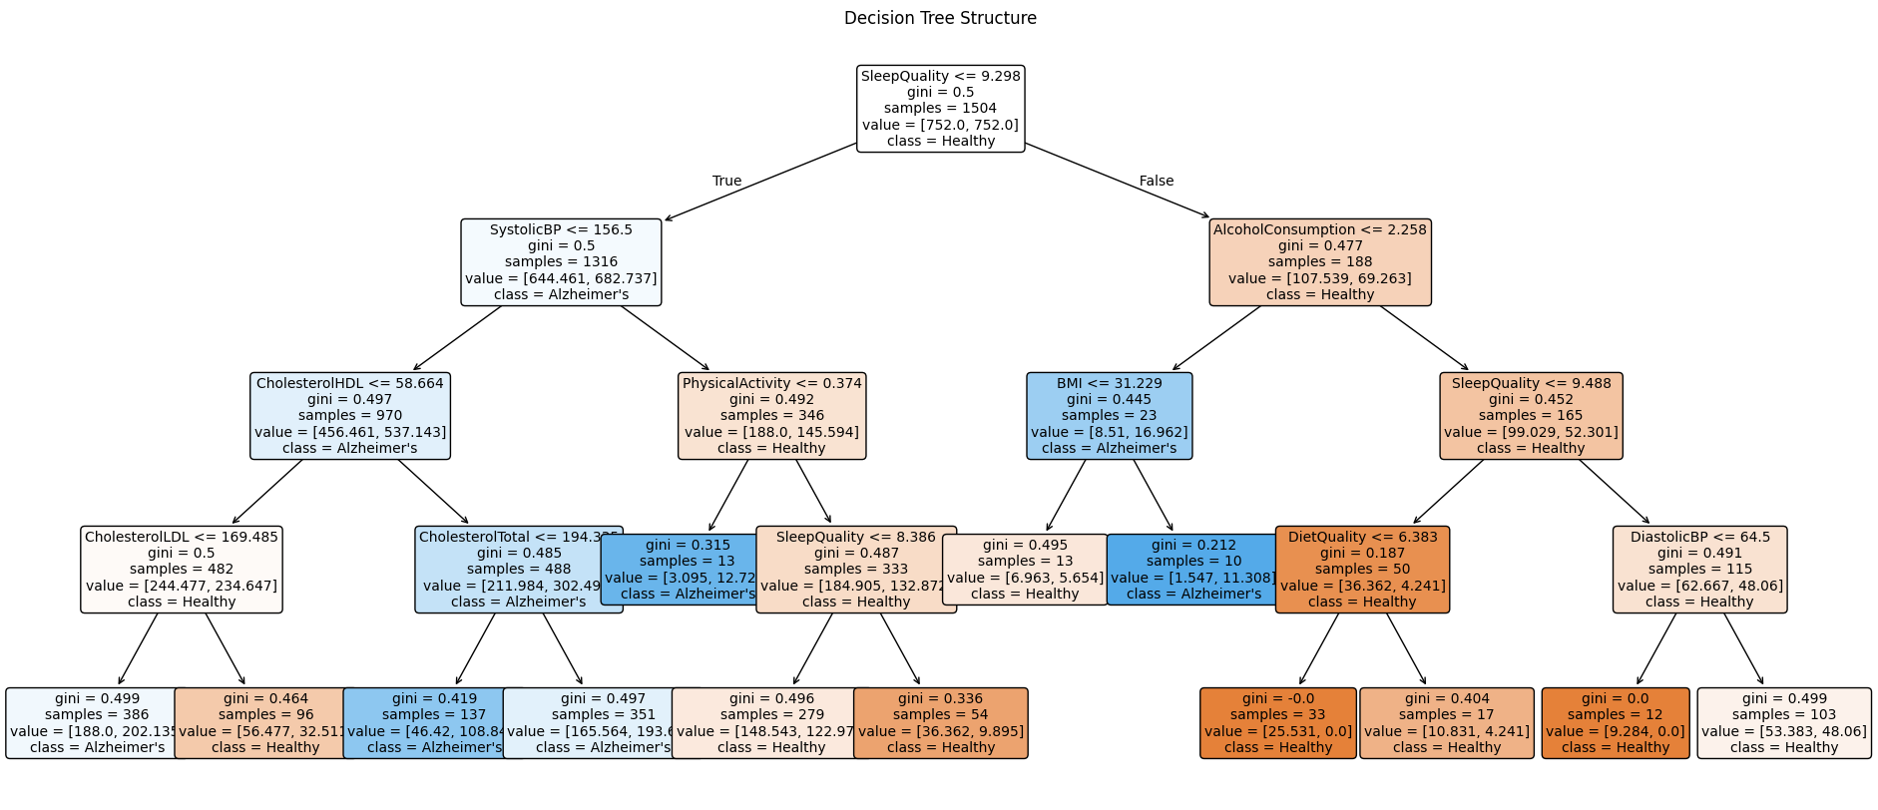
Results for the Risk-only Dataset (No LLE + DT)
Notes:
We used the ROC AUC metric to evaluate performance as well, which captures the area under the curve and tells us how good our model is at classifying our datasets in skewed datasets (meaning datasets that don’t have equal number of people with and without alzheimer’s).

Slide 14
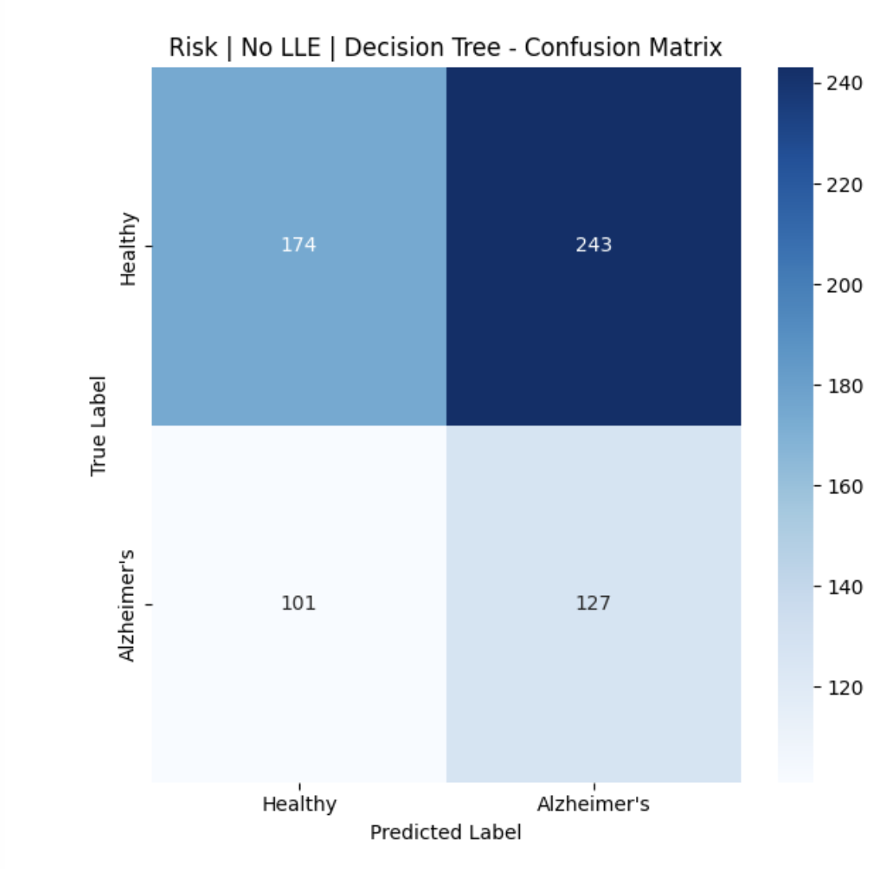
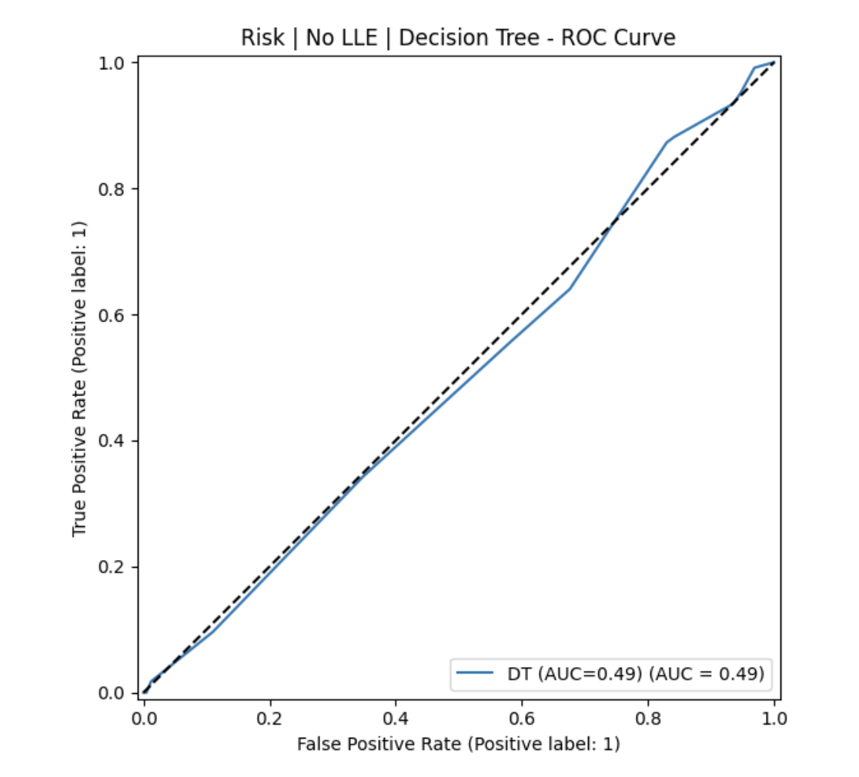
Results for the Risk-only Dataset (No LLE + DT)
Notes:
We used the ROC AUC metric to evaluate performance as well, which captures the area under the curve and tells us how good our model is at classifying our datasets in skewed datasets (meaning datasets that don’t have equal number of people with and without alzheimer’s).

Slide 15
No LLE + DT
Sensitivity | 0.557
Specificity | 0.417
Accuracy | 0.467
ROC AUC | 0.494
Notes:
So when we evaluate the confusion matrix and ROC AUC curve. We can see:
Our model is not detecting actual people with Alzherimers (true cases) and is getting a bit worse at detecting people without Alzheimer’s (true negatives). And since its a bit worse at detecting actual healthy people, our ROC drops again to just below 50%.

Slide 16
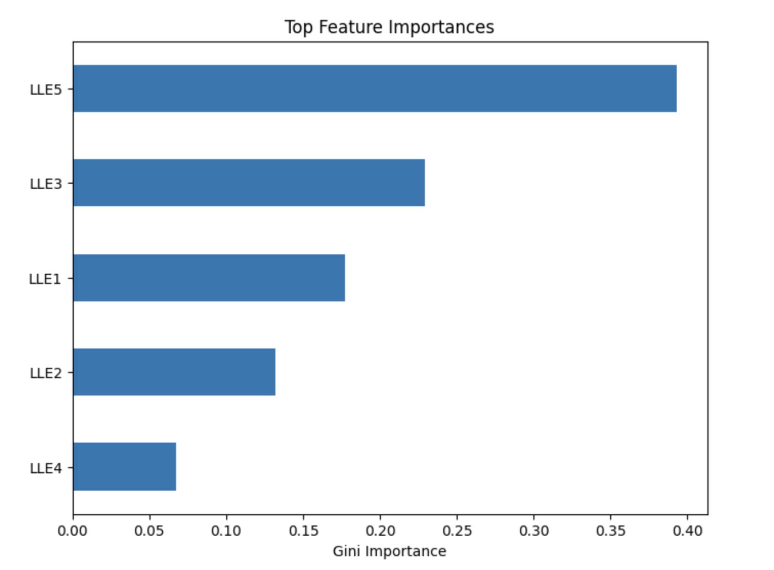
Results for the Risk-only Dataset (LLE + DT)
Notes:
We used the ROC AUC metric to evaluate performance as well, which captures the area under the curve and tells us how good our model is at classifying our datasets in skewed datasets (meaning datasets that don’t have equal number of people with and without alzheimer’s).

Slide 17
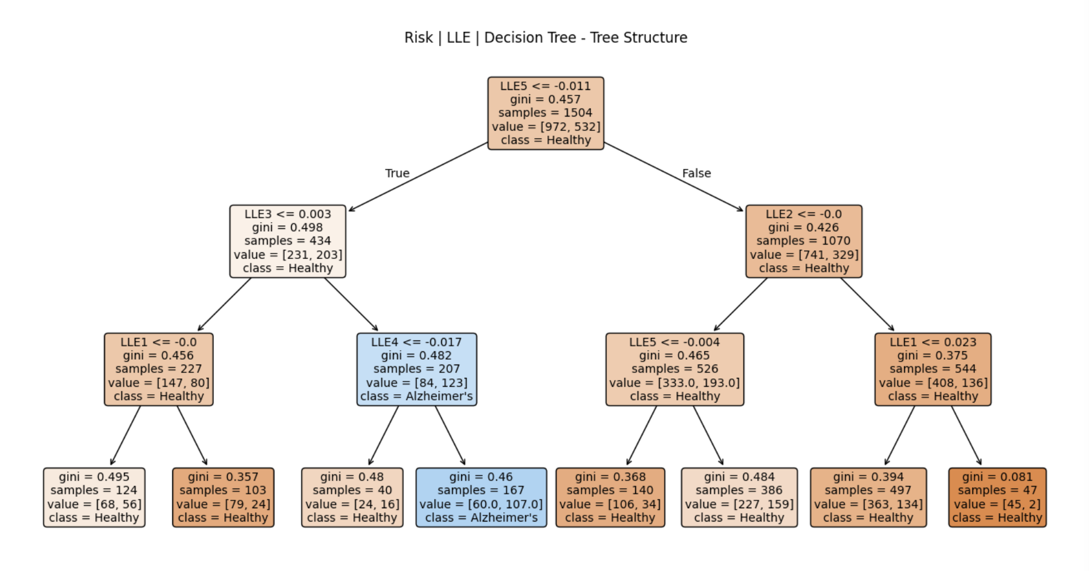
Results for the Risk-only Dataset (LLE + DT)
Notes:
We used the ROC AUC metric to evaluate performance as well, which captures the area under the curve and tells us how good our model is at classifying our datasets in skewed datasets (meaning datasets that don’t have equal number of people with and without alzheimer’s).

Slide 18
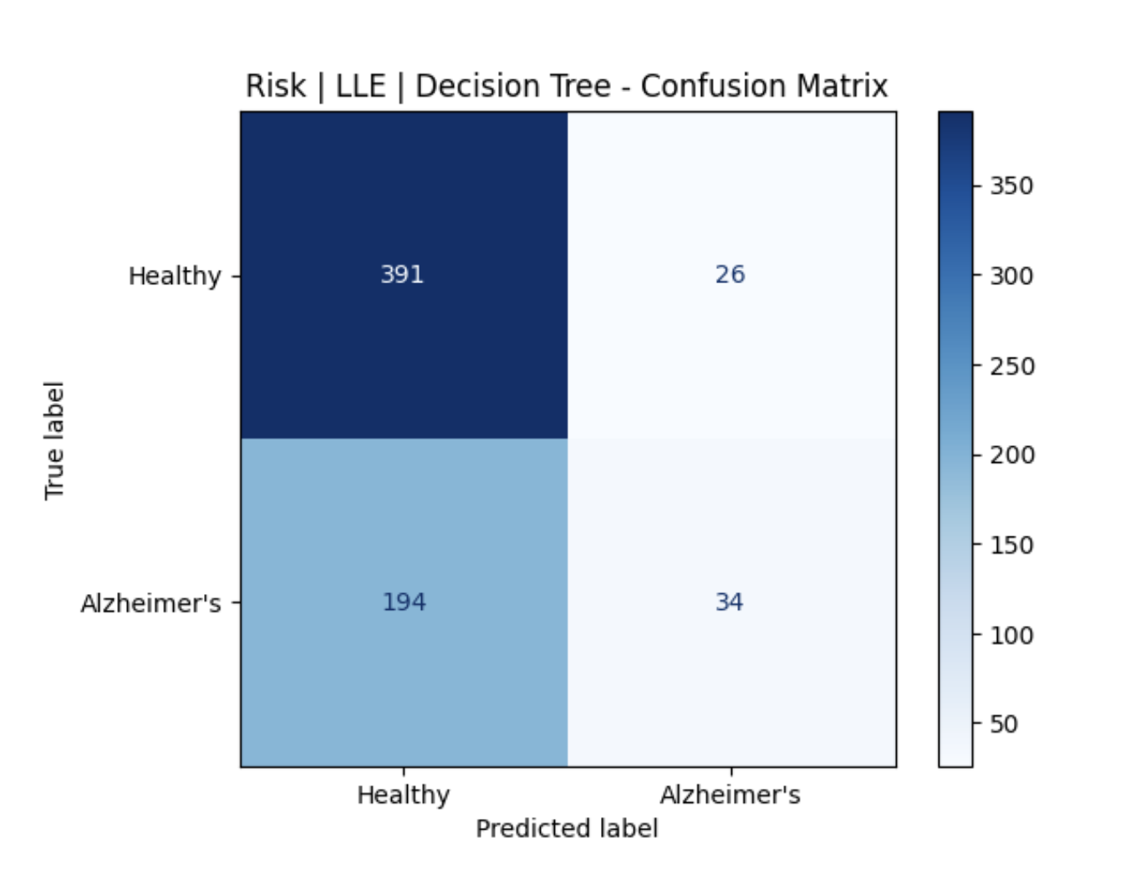
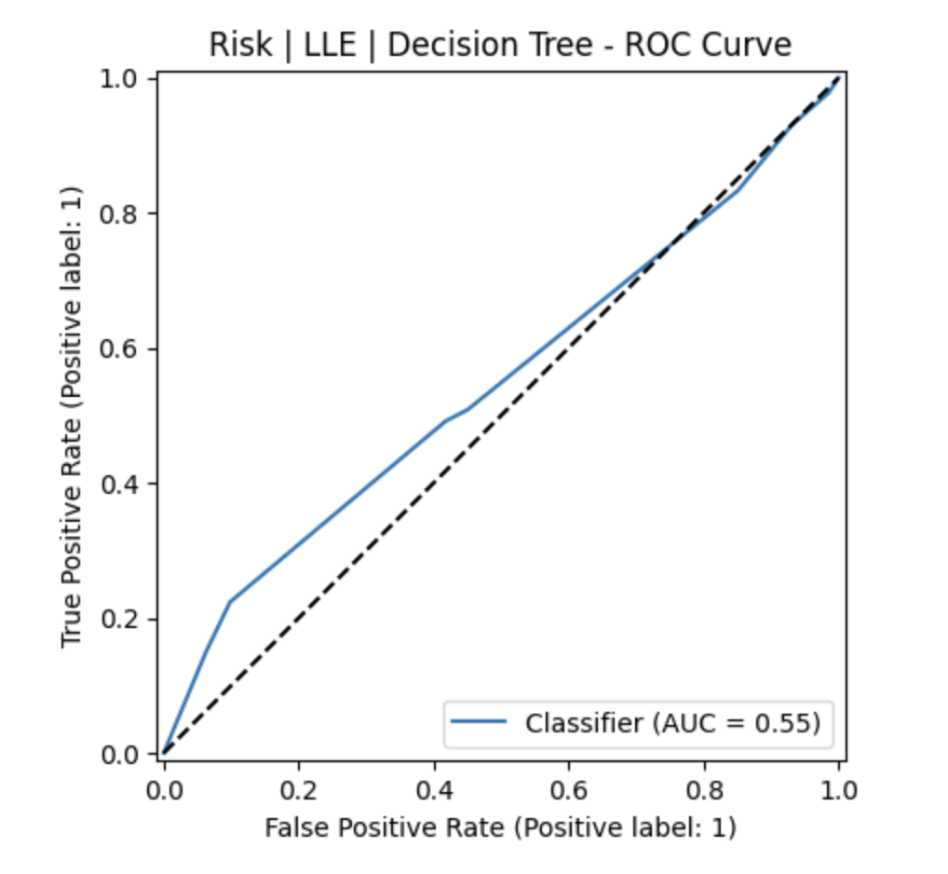
Results for the Risk-only Dataset (LLE + DT)
Notes:
We used the ROC AUC metric to evaluate performance as well, which captures the area under the curve and tells us how good our model is at classifying our datasets in skewed datasets (meaning datasets that don’t have equal number of people with and without alzheimer’s).

Slide 19
No LLE + DT
Sensitivity | 0.557
Specificity | 0.417
Accuracy | 0.467
ROC AUC | 0.494
LLE + DT
Sensitivity | 0.15
Specificity | 0.94
Accuracy | 0.548
ROC AUC | 0.659

Slide 20
Support Machine Vector

Slide 21
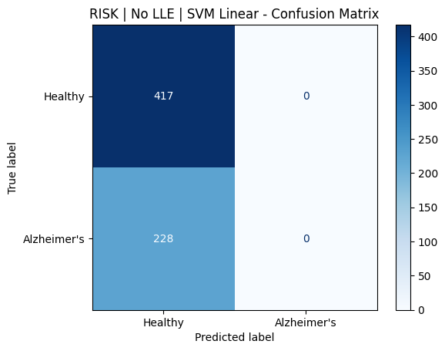
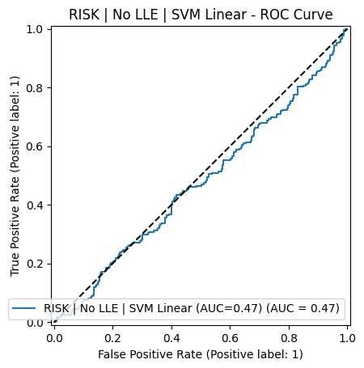
Results for the Risk-only Dataset (No LLE + SVM linear)
Notes:
Here is the confusion matrix and ROC curve for the first analysis. So we didn’t reduce the data through LEE + and used a linear SVM to attempt to classify the data. This model is classifying all people - healthy or with alzhiemers - as being healthy so this doesn’t work really well.
We used the ROC AUC metric to evaluate performance as well, which captures the area under the curve and tells us how good our model is at classifying our datasets in skewed datasets (meaning datasets that don’t have equal number of people with and without alzheimer’s).

Slide 22
No LLE + SVM-linear
Sensitivity | 0.0000
Specificity | 1.0000
Accuracy | 0.6465
ROC AUC | 0.4731
Notes:
When we evaluate the confusion matrix and the ROC curve, our model is a bit rough. Our model is the worse it could be at detecting positive cases (i.e. people with alzheimers), which is our sensitivity. Is amazing at capturing negative cases (i.e. people with healthy) which is our specificity. And our accuracy, taking into account skewed datasets, is less than 50%.

Slide 23

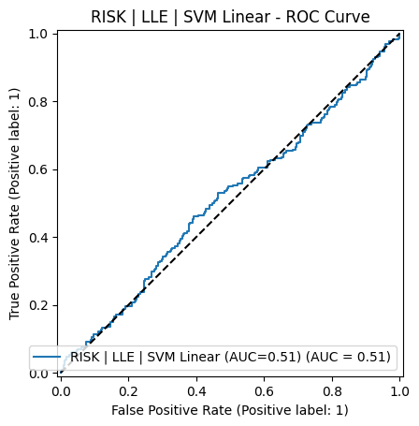
Results for the Risk-only Dataset (LLE + SVM linear)
Notes:
Here is our next confusion matrix and ROC curve. So we reduced the data through LLE + and used a linear SVM again. This model is classifying all people again - healthy or with alzhiemers - as being healthy so this doesn’t work really well.

Slide 24
No LLE + SVM-linear
Sensitivity | 0.0000
Specificity | 1.0000
Accuracy | 0.6465
ROC AUC | 0.4731
LLE + SVM-linear
Sensitivity | 0.0000
Specificity | 1.0000
Accuracy | 0.6465
ROC AUC | 0.5101
Notes:
When we crunch the confusion matrix numbers and calculate the ROC curve, we get another rough model.
Our model is not detecting actual people with Alzherimers (true cases) and is amazing at detecting people without Alzheimer’s (true negatives). Our ROC accuracy improved a bit with the data reduction preprocessing step, but not dramatically as it’s just over 50%.

Slide 25

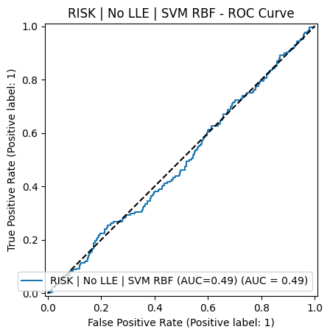
Results for the Risk-only Dataset (No LLE + SVM RBF)
Notes:
Here is our next confusion matrix and ROC curve. So we go back to not reducing through LLE + and used a rbf kernel for our SVM - which essentially draws a non-linear decision boundary to attempt to classify the data. This model is classifying most people - healthy or with alzhiemers - as being healthy so it’s a step up but not great.

Slide 26
No LLE + SVM-linear
Sensitivity | 0.0000
Specificity | 1.0000
Accuracy | 0.6465
ROC AUC | 0.4731
LLE + SVM-linear
Sensitivity | 0.0000
Specificity | 1.0000
Accuracy | 0.6465
ROC AUC | 0.5101
No LLE + SVM-rbf
Sensitivity | 0.0000
Specificity | 0.9952
Accuracy | 0.6434
ROC AUC | 0.4923
Notes:
So when we evaluate the confusion matrix and ROC AUC curve. We can see:
Our model is not detecting actual people with Alzherimers (true cases) and is getting a bit worse at detecting people without Alzheimer’s (true negatives). And since its a bit worse at detecting actual healthy people, our ROC drops again to just below 50%.

Slide 27

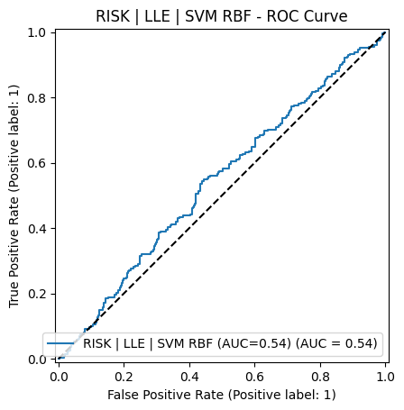
Results for the Risk-only Dataset (LLE + SVM RBF)
Notes:
Here is our last confusion matrix and ROC curve. So we did reduce the data through LEE + and used a rbf non-linear kernel for our SVM. This model is classifying most people - healthy or with alzhiemers - as being healthy still.

Slide 28
No LLE + SVM-linear
Sensitivity | 0.0000
Specificity | 1.0000
Accuracy | 0.6465
ROC AUC | 0.4731
LLE + SVM-linear
Sensitivity | 0.0000
Specificity | 1.0000
Accuracy | 0.6465
ROC AUC | 0.5101
No LLE + SVM-rbf
Sensitivity | 0.0000
Specificity | 0.9952
Accuracy | 0.6434
ROC AUC | 0.4923
LLE + SVM-rbf
Sensitivity | 0.0044
Specificity | 0.9976
Accuracy | 0.6465
ROC AUC | 0.5409
Notes:
When we evaluate the confusion matrix and ROC AUC curve. We can see:
Our model is getting a wee bit better at detecting actual people with Alzherimers (true cases) and is getting a bit worse at detecting people without Alzheimer’s (true negatives). But overall we are moving in the right direction as our ROC AUC is going up to 54%.

Slide 29
Conclusion
LLE + DT performs the best at 66%, followed by LLE + SVM-RBF at 54%
Data reduction helps model performance
Sleep Quality far outperforms other risk factors in classification
RBF outperforms Linear kernel in SVM
Our models are not (YET) clinically useful

Slide 30
Next steps
Poor model performance overall
Optimize LLE performance?
Mitigate Bias (Class-Weighting)
Revisit which variables to include/exclude?
Compare performance

Slide 31
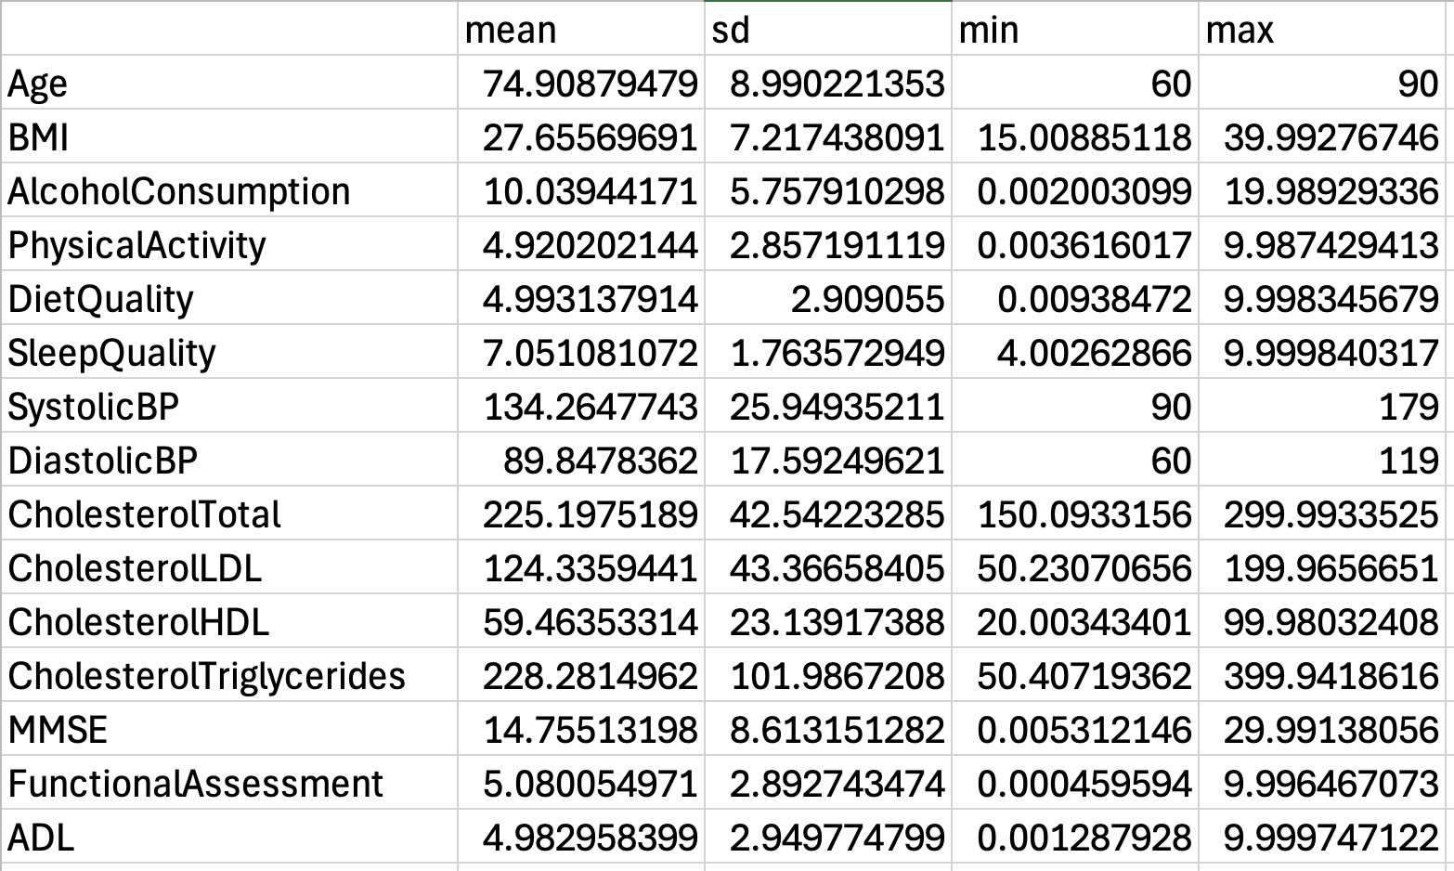
Appendix - Descriptives (continuous)

Slide 32
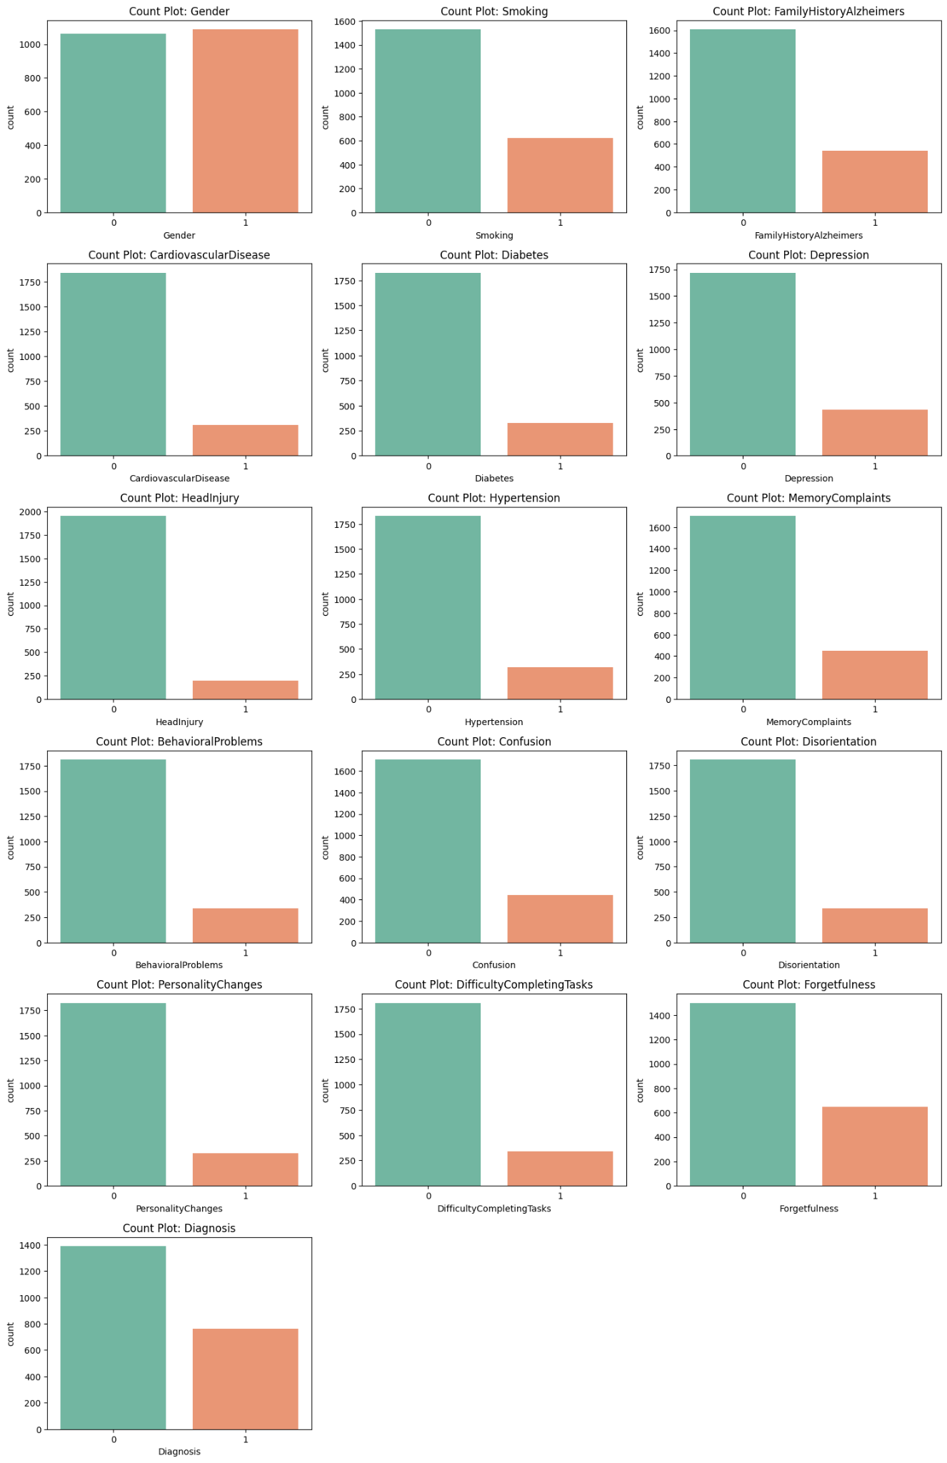
Appendix - Descriptives (categorical)

Slide 33
Appendix - Descriptives (categorical)

Slide 34
Appendix - Descriptives (categorical)

